Slide 1
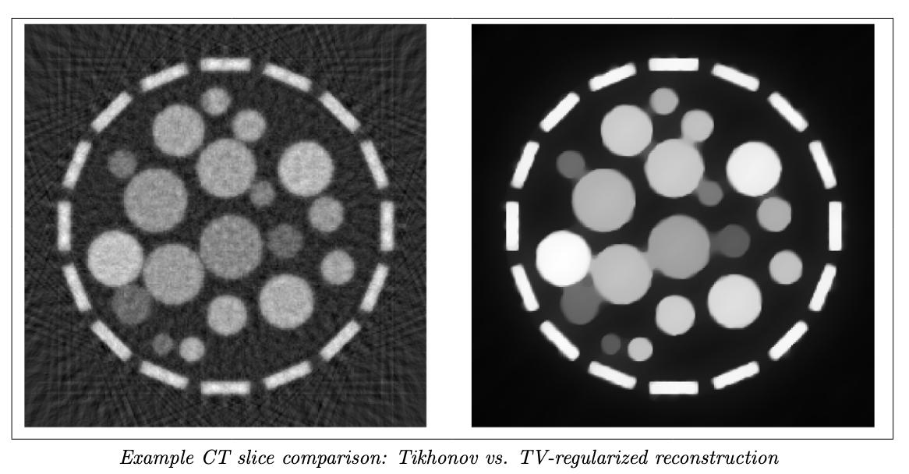
Standardizing CT Reconstructions via Learned Mappings Between Iterative Methods
Inverse Problems in Imaging
Jochem Lange, Pepijn Vermeulen, Gijs Bartholomeus

Slide 2
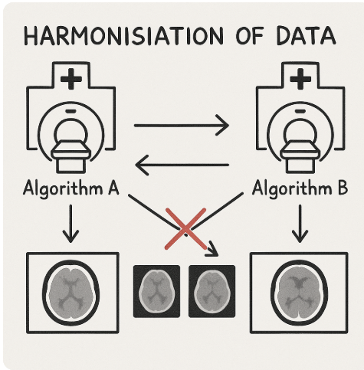

Problem overview
🏥 Understand differences in CT image reconstruction: Compare how different reconstruction algorithms affect the final medical images from the same sinogram data. Investigate the effect of noise on both methods.
🔁 Investigate harmonisation: Develop methods to harmonise images reconstructed by different algorithms so that they can be meaningfully shared and interpreted across hospitals.
🔎 Investigate transformation: Explore whether images from one reconstruction method can be transformed to resemble another.

Slide 3
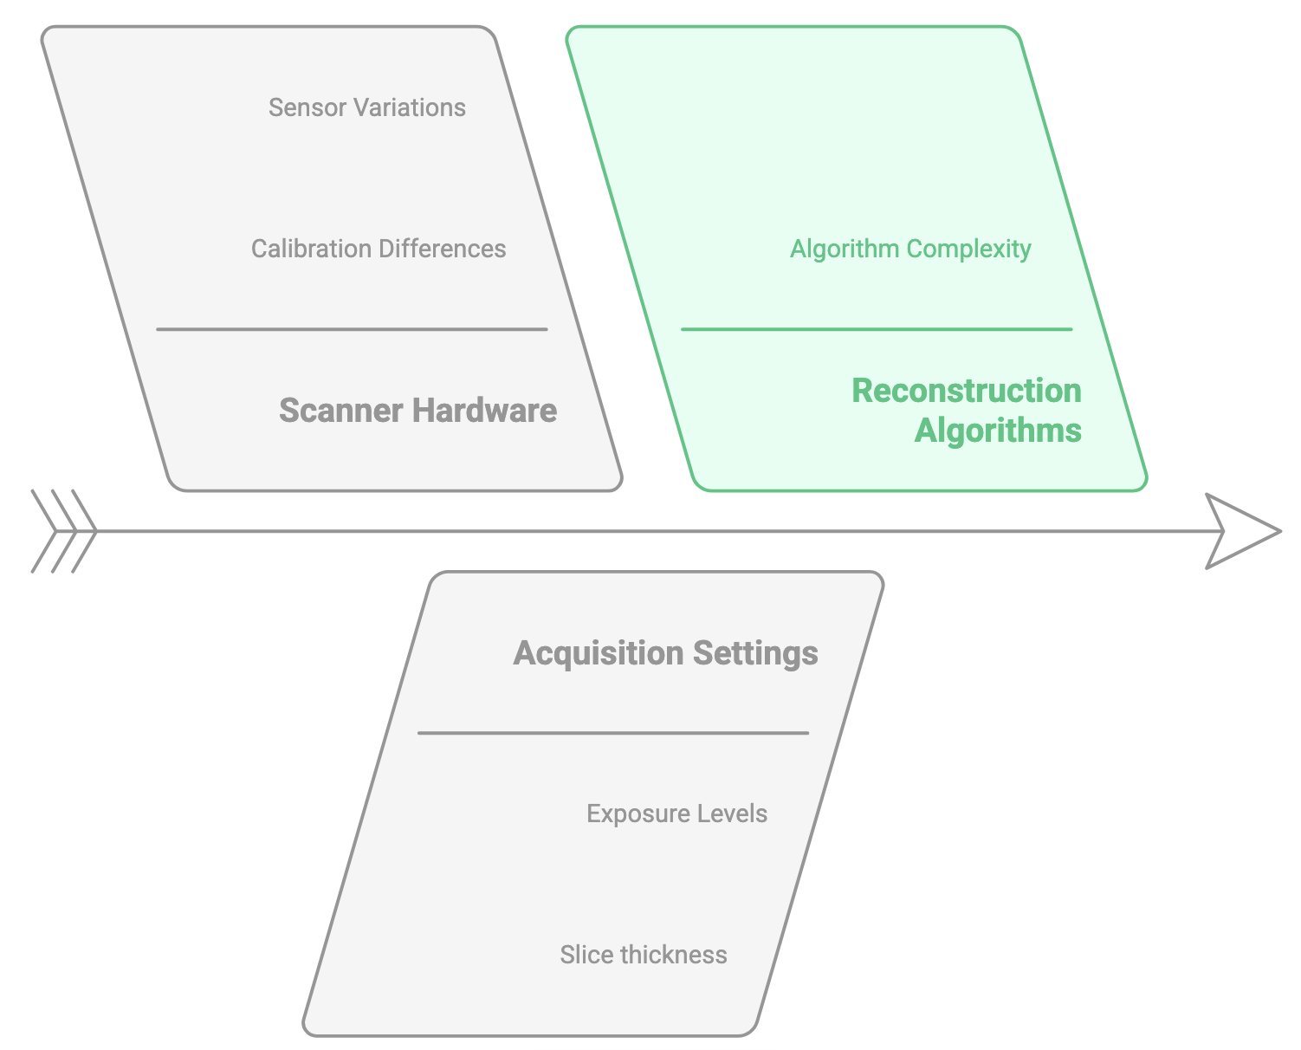
Project overview
🏥 Isolate one variable:
Reconstruction algorithm

Slide 4
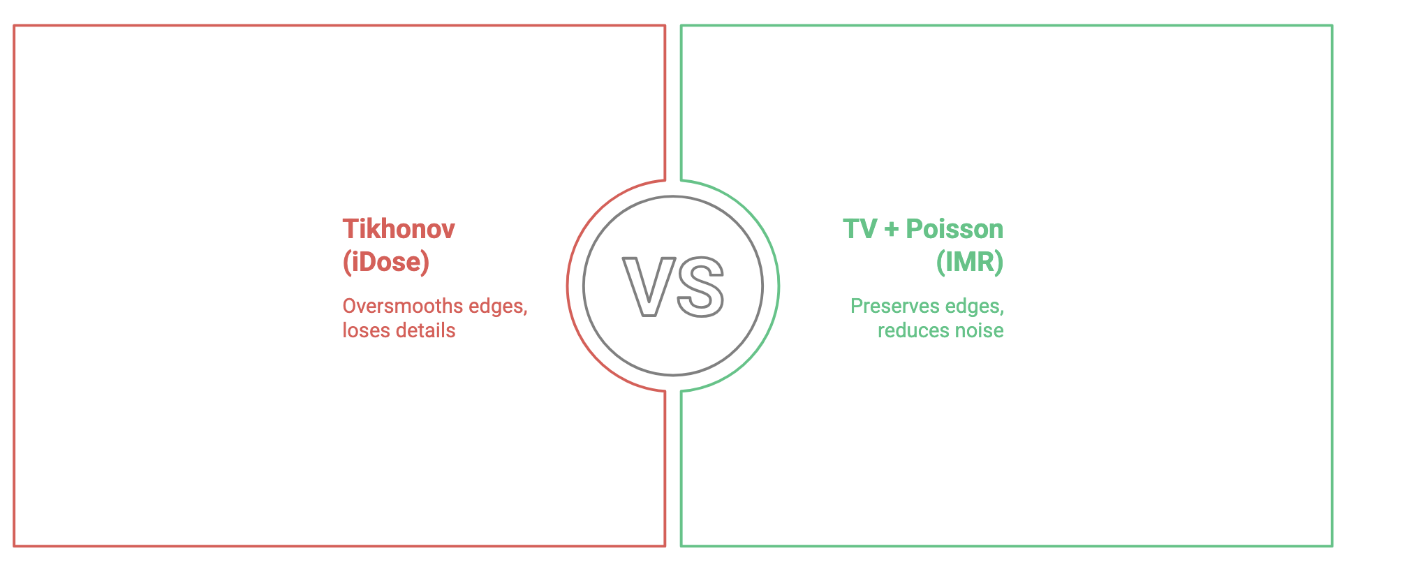
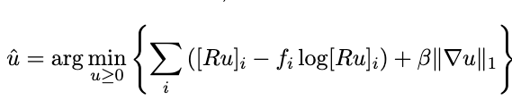

Reconstruction algorithms

Slide 5
Reconstruction algorithms: Results
dhfh

Slide 6
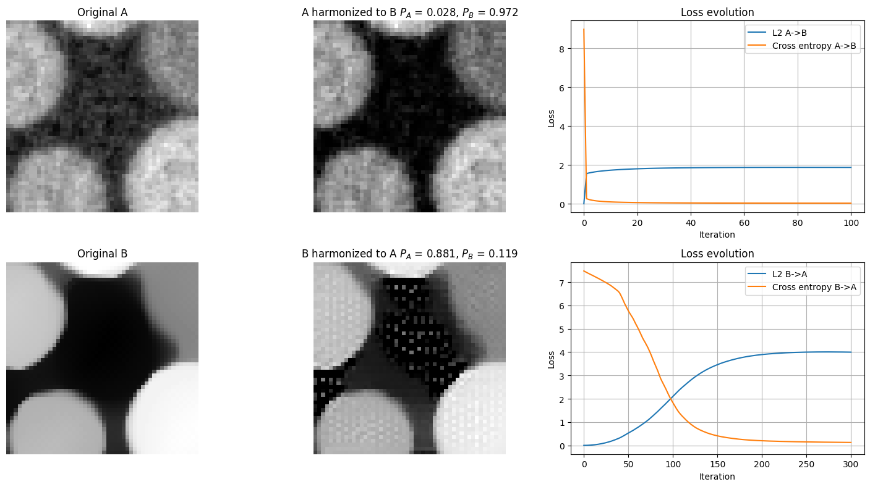
Transformation/Harmonization
hdhdfh

Slide 7
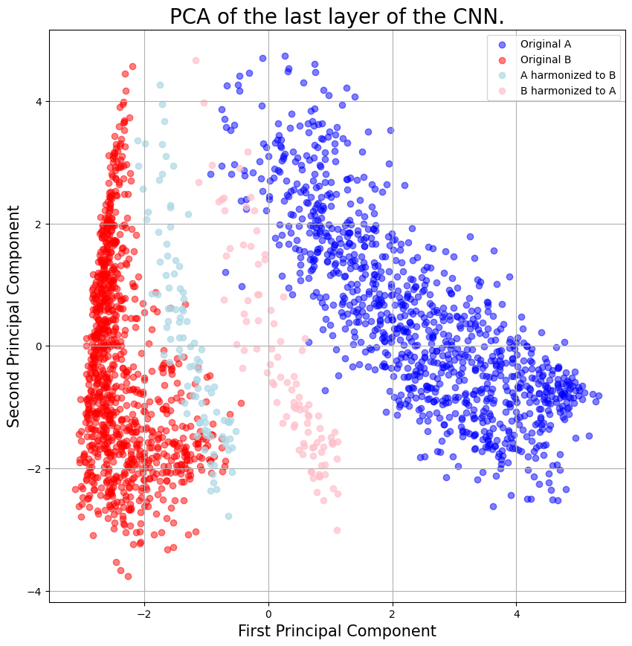
PCA
dd

Slide 8
Thankword
djdfjd

